Slide 1

IoT Based Third Eye For Visually Challenged

Slide 2
TEAM MEMBERS
Maadhavan U (22504167)
Aarthi K (22591780)
Abinaya A (22591781)
Akash V (22591784)
Barath Krishnan N (22591785)
Tilak Raj G (22591809)

Slide 3
AGENDA
Abstract
Introduction
Existing System
Disadvantages
Proposed System
Advantages
System requirements
Project Description
Overall diagram
Modules
Conclusion

Slide 4
ABSTRACT
The third eye for blind is an innovation that helps the blind people to navigate with speed and confidence.
It uses a pair of ultrasonic sensors to detect the obstacles .
Each ultrasonic sensor is placed on the right side and left side of the system respectively.
The obstacles are notified to the blind using buzzer and vibration modules.

Slide 5
The buzzer and vibration module are kept beside each ultrasonic sensor of the system.
It will be a wearable technology for blinds.
It also consists of a GPS module which enables to send SOS message along with the current location.
The SOS message is sent only when a push button is pressed.

Slide 6
INTRODUCTION
The project helps the blind people to run their life as usual.
According to WHO, 39 million people are estimated as blind worldwide.
The affected ones have been using traditional white cane for many years which has many disadvantages.
The proposed system is more efficient way to help visually impaired people navigate with great comfort, speed and confidence

Slide 7
OBJECTIVE
The objective of project IoT based Third EyeFor visually Challenged is
To design portable wearable device for the visually impaired and those who often must relay on others.
To help the visually impaired people to move around from one place to another with confidence.
To ensure the well being of the person by sending SOS message in case of emergency.

Slide 8
Existing System
The major exiting systems are
White Cane
Pet dog
Smart Devices(eg:Vision a torch for blinds)

Slide 9
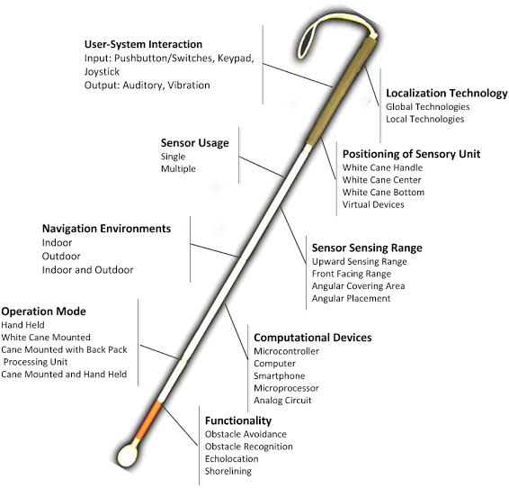
White Cane
It is a device used by many people who are blind or visually impaired.
It allows its users to scan their surroundings for obstacles.

Slide 10
Disadvantages
May crack or break easily
The stick may get stuck at the foot path cracks
Difficult to handle at crowded place
High chances for getting missed

Slide 11
Pet dog
The pet dogs can be used by the blind to navigate across the path.
For this, the dogs are properly trained by the professional.
This also ensures the security of blind or visually impaired in many cases.

Slide 12
DISADVANTAGE
Expensive
Difficult to maintain
Requires skill to handle
Not a permanent solution
Difficulties are experienced in new places

Slide 13
Vision
Vision is a smart device used is used by blind or visually impaired to navigate their path.
This uses ultrasonic waves to detect the obstacles and notify the user using a buzzer and vibration module.
This idea was inspired from the bats, which use high frequency sound waves to move.

Slide 14
Disadvantage
Difficult to carry
Requires skill to use
High chances of getting dropped
Inconvinient to use

Slide 15
To find the best outcome, repeat the process using many other classifications such as naïve bayes classifier,svm,knn,random forest and create learning model to test on the same dataset.
The best outcome is gained when the graph has maximum detection rate and lowest false positive rate

Slide 16
SYSTEM REQUIREMENTS
Hardware required:
1) any intel core I series processor
2) os windows 10 or above
Software required:
1) Anaconda (jupiter)
2) Python (program language)

Slide 17
SOFTWARE DESCRIPTION
Anaconda is a Python distribution (prebuilt and preconfigured collection of packages) that is commonly used for data science.
The Anaconda distribution includes the Conda package manager in addition to the preconfigured Python packages and other tools.
Anaconda Navigator is a GUI tool that is included in the Anaconda distribution and makes it easy to configure, install, and launch tools such as Jupyter Notebook.

Slide 18
MODULES
There are three modules in our project
Training phase
Detection phase
Testing phase
MODULE DESCRIPTION :
Training Phase:
In training phase the data set are analysed and features are extracted, from the features extracted model is trained with different dataset. For training we will use the machine learning algorithm

Slide 19
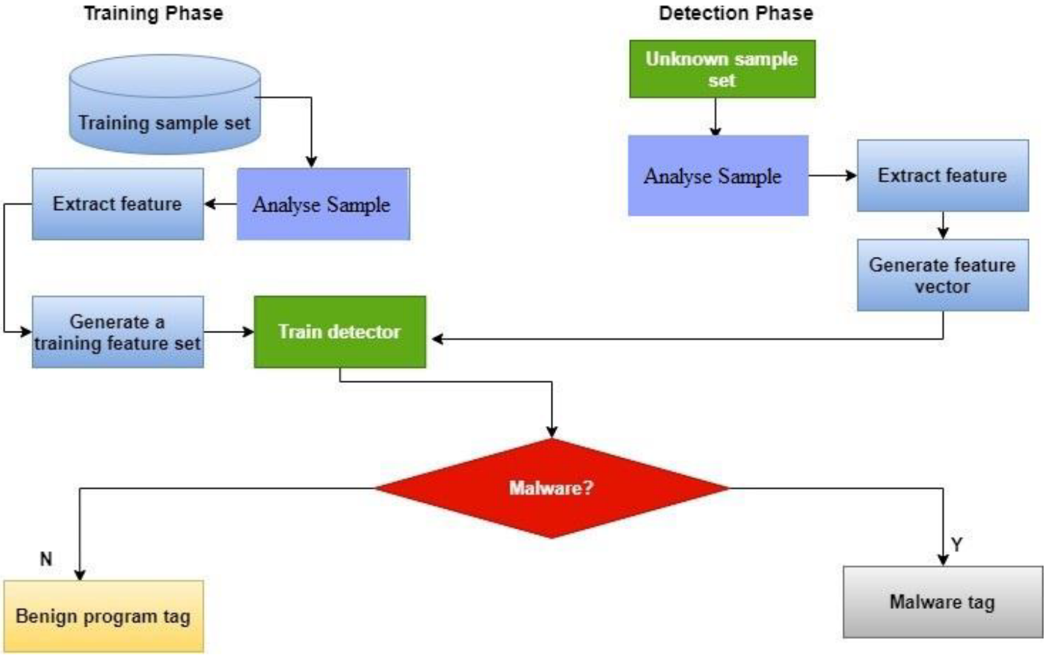
Testing Phase:
In testing phase the model is test and we can find malware with different test data set samples.

Slide 20
Detection Phase:
In detection phase by using unknow data samples or sets we will analysis the model features and generate the feature vectors.

Slide 21
Conclusion
In this research, we have proposed a malware detection module based on
advanced data mining and machine learning. While such a method may not be
suitable for home users, being very processor heavy, this can be implemented at
enterprise gateway level to act as a central antivirus engine to supplement
antiviruses present on end user computers. This will not only easily detect
known viruses, but act as a knowledge that will detect newer forms of harmful
files. While a costly model requiring costly infrastructure, it can help in
protecting invaluable enterprise data from security threat.

Slide 22
THANK YOU

